Slide 1
Introducing SGADISA
Harriet Cannon
Disability Advisory Team Manager
Disability Services
h.a.cannon@adm.leeds.ac.uk

Slide 2
What is SGADISA?
Pre-built form in Banner
Developed to record adjustments to learning and teaching
Works in combination with Argos reporting tool
Easier to download consistent information

Slide 3
How does SGADISA work?
Quite basic!
Similar to SWAMEDI – code and descriptor
No free text or comment boxes
Limited functionality

Slide 4
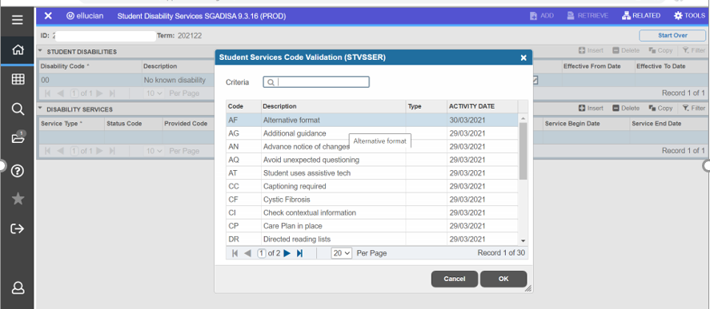
SGADISA interface

Slide 5
What are the SGADISA codes?
List of 30 codes
All codes relate to learning and teaching
Most replicate existing Summary Sheet codes
Some new codes
Full list is available online at https://ses.leeds.ac.uk/staffguidance

Slide 6
How does DS decide which codes to use?
We take information from the student’s:
  Sign up form
  Evidence
  Other information (e.g. Needs Assessment)
  Knowledge of disability and common barriers
+ a standardised list of adjustments by disability type.

Slide 7
How do I access SGADISA codes?
Directly via Banner (individual students)
Via pre-set Argos report
Argos report allows for filtering by:
    Individual
    Module group
    Programme group
    Adjustment group
All Argos data is live as it comes from Banner.

Slide 8
Will every disabled student have a SGADISA record?
Not immediately.
Start entering codes for 2022-23 intake
Will continue with each new intake
Won’t have full records for 3-4 years
Schools must continue to use Support Summary Sheets for other year groups.

Slide 9
Will we still need to use Support Summary Sheets?
Yes!
SGADISA supplements Support Summary Sheets – does not replace them
No free text on SGADISA – contextual info still lives on Summary Sheets
Will need Summary Sheets for all other year groups
Devised a new Summary Sheet template

Slide 10
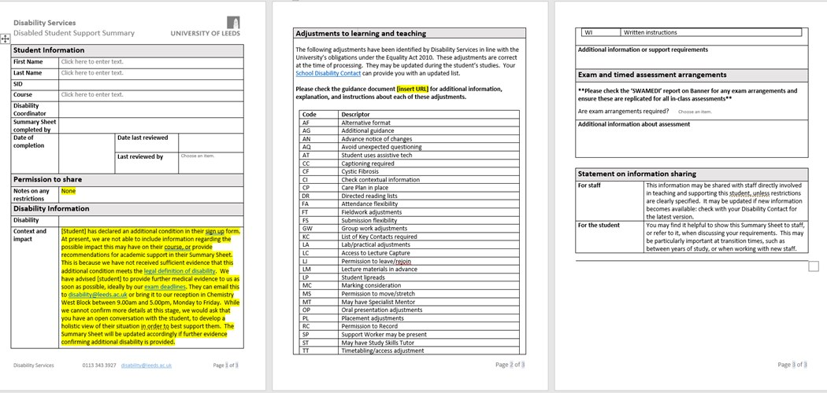
New Summary Sheet template

Slide 11
Will we still need to use SWAMEDI?
Yes!
SGADISA does not replace SWAMEDI
SGADISA and SWAMEDI are not linked
No disability code in SGADISA
SWAMEDI still used for exam access adjustments, disability type and funding status (HESA returns)
Still need to use SWAMEDI for in-course assessments

Slide 12
When will you start using SGADISA?
We will use SGADISA for the 2022-23 intake
Creating SGADISA records from March/April onwards
Remember: only 2022-23 starters will have a SGADISA record initially!

Slide 13
Is there further guidance on the codes?
Yes!
New guidance document
    Explains each code
    Gives instructions for action
Guidance is available from https://ses.leeds.ac.uk/staffguidance
Link to guidance on every Summary Sheet

Slide 14
How do I get access to Argos?
You may already have access, so check first
Request access via the IT Self Service Tool
    Type ‘Argos Access’ into the search bar
    Follow the instructions

Slide 15
Over to you…
Questions
Comments
Use the ‘hands up’ feature, or put a question in Chat.

