Slide 1
Supporting autistic students
Harriet Cannon
Disability Advisory Team Manager
Disability Services
h.a.cannon@adm.leeds.ac.uk

Slide 2
Autism is one word attempting to describe millions of different stories.
Stuart Duncan

Slide 3
What is autism?
Definition: “Lifelong neuro-developmental disability”
Different neurotype
Perceived differences in neuronormative social interaction, communication and sensory perception
Not a mental health condition and not an SpLD
Unknown cause; no known ‘cure’ but numerous support strategies
Approximately 1 in 100 people in UK diagnosed as autistic (huge underestimate – 1 in 30?)

Slide 4
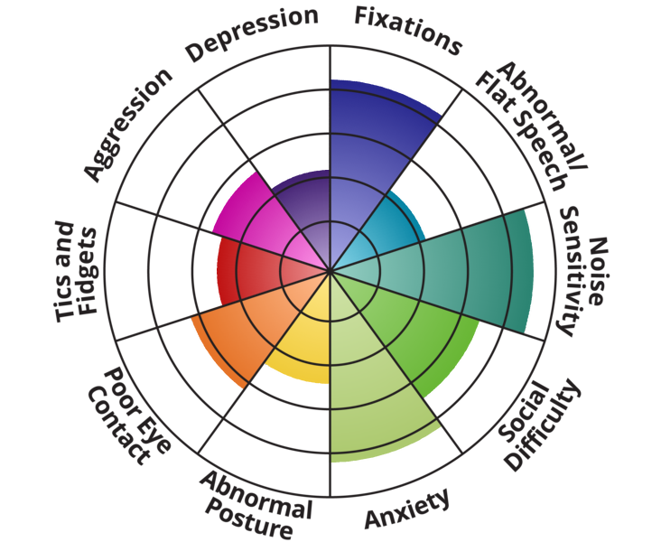
Autism as a spectrum?
‘Low functioning’
‘High functioning’
‘Severe’
‘Mild’
Autism + Environment = Disability
IDRlabs

Slide 5
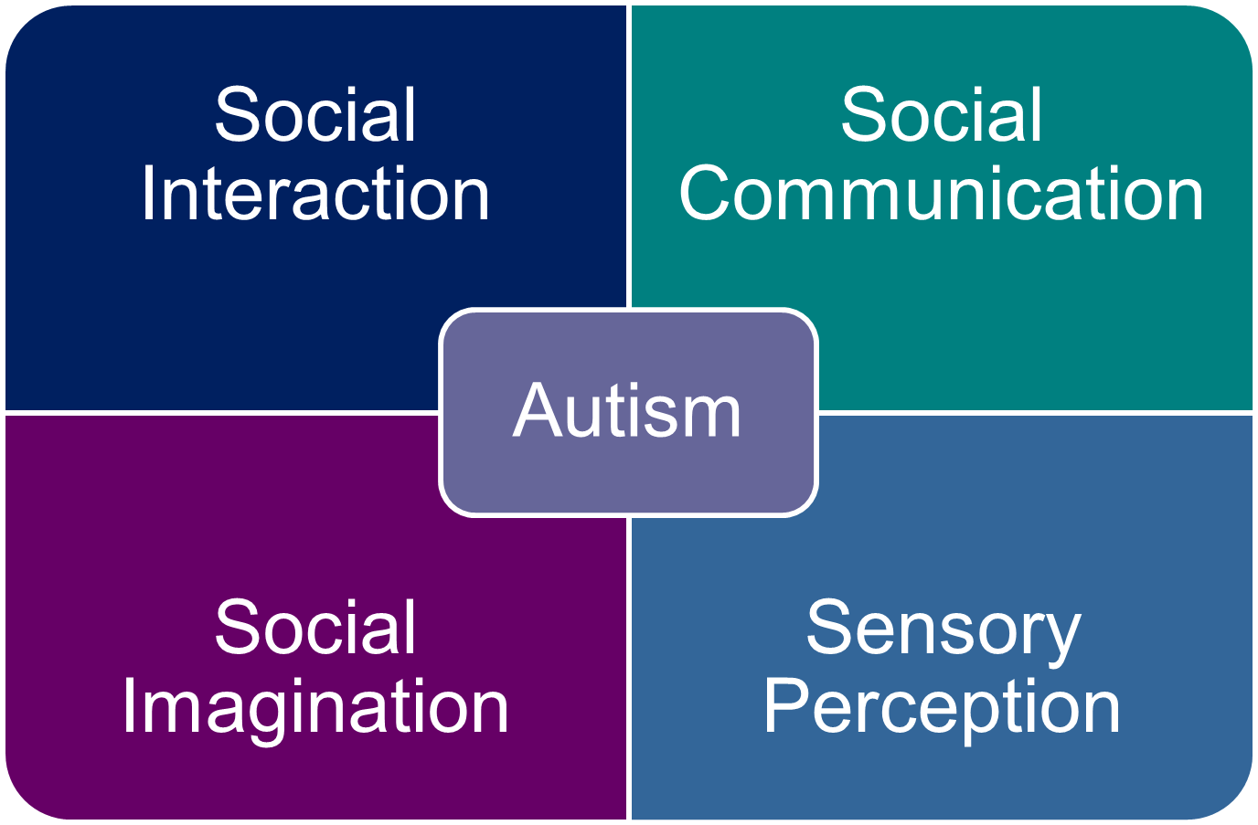
Clinical diagnostic features of autism

Slide 6
A word on the deficit model…
Autism is diagnosed using a neurotypical deficit model
Based on what someone can’t do, or ways in which they lack something, or deviate from what is considered normal
Words like ‘difficulty with’, ‘challenges’, ‘struggles’, ‘unable to’, ‘lacks’ etc frequently used
Invalidates neurodivergence
Difficulty = difference made difficult due to social barriers, neuronormative bias and no understanding

Slide 7
Social interaction (through a neurotypical lens)
Appearing to be different to (neurotypical) others or socially isolated
Reading neurotypical social cues
Behaving ‘unusually’ i.e. not following neurotypical social norms
Appearing to lack empathy (‘double empathy problem’)
Unusual eye contact
Can be learnt…or mimicked = ‘masking’

Slide 8
Social communication (through a neurotypical lens)
Understanding neurotypical tone, intonation, facial expression
Literal interpretation of figurative speech
Apparent difficulty holding a neurotypical two-way conversation (with neurotypical people)
Difficulty asking for help
Appearing to have poor concentration or listening skills
Being honest to the point of bluntness
Can be taught…or mimicked = ‘masking’

Slide 9
Social imagination (through a neurotypical lens)
Nothing to do with creative imagination!
Perceived difficulty with neurotypical predicting or anticipating
Perceived difficulty in foreseeing neurotypical consequences
Anxiety at changes to routine
Liking set rules, routines and appearing to over-react to others’ infringement of these
Differences in imagining another’s neurotypical point of view in a neurotypical way
Particular focussed interests

Slide 10
Sensory perception
We have more than 5 senses!
Sensory hyper- or hypo-sensitivity (experiencing too much or too little)
Hypersensitivity = overload and can be physically painful
Causes ‘interference’
Hyposensitivity can lead to wellbeing issues.
Common challenges: noisy environments, crowded spaces, bright lighting, texture of clothing, unwanted physical touch, smells, taste, feeling the heat or the cold etc.

Slide 11
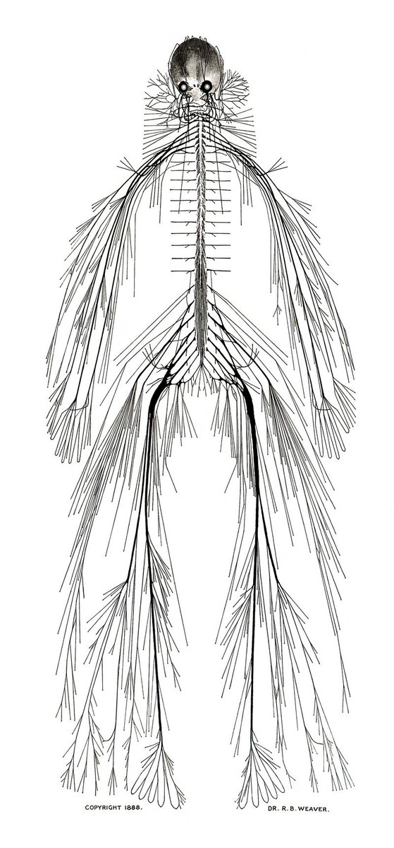
So, what is autism really?
Autism is a type of neurological system
Neurology is not just in the brain
Our neurological system processes and translates information to create action
Input and output
Autistic neurology is different:
More information = more input
Different processing = different output
Autistic people experience everything autistically
Not broken, not worse, not disordered, not less

Slide 12
Noticeable characteristics (in some people)
Not following social norms, not displaying neurotypical ‘behaviour’
Unusual eye contact and/or facial expressions
Unusual tone of voice or style of expression
Signs of anxiety or discomfort
‘Stimming’ (‘scratching a neurological itch’)
Sensory hypersensitivity (can look distracted)
Not responding / taking a long time to respond
Speaking at length about a topic of interest which is of no relevance to situation
…or none at all due to masking

Slide 13
Masking / Camouflaging
Imitating facial expressions
Bottling up anxiety
Suppressing stims
Trying to fit in
Hiding emotions
Trying to focus
Acting ‘normal’
Forcing eye contact
Exhaustion
Burnout
Loss of identity
Misdiagnosis

Slide 14
Understanding autism – a few theories
Neurodiversity and neurodivergence
Autism as a neurotype
Double empathy problem
Monotropism

Slide 15
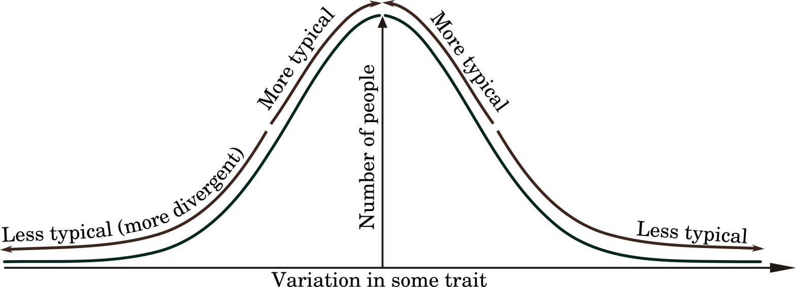
Neurodiversity and Neurodivergence
Neurodiversity recognises that no two human brains are alike
Subset of biodiversity: critical to stability, sustainability, adaptability
Neurodiversity is a fact, but also a paradigm for social change
Humanity is neurodiverse but individuals may be neurodivergent
http://oolong.co.uk

Slide 16
Autism as a neurotype
There are multiple neurotypes because of neurodiversity
There is a Predominant Neurotype (PNT) to which most people conform (neurotypicality)
Those whose neurotype does not conform to the PNT are neurodivergent.
Groups who share the same divergence may be a neuro-minority.

Slide 17
Neurodivergence and neurominorities
Autism
Dyslexia
AD(H)D
Dyspraxia
Dyscalculia
Tourette Syndrome

Slide 18
Double empathy problem
Neurotypical + neurotypical
Mutual incomprehension due to differing perspectives and experiences impeding successful communication and understanding. Empathy is a two-way street.
Autistic + autistic
Neurotypical + autistic

Slide 19
Monotropism
Attention is finite and must be distributed between different interests, emotions, thoughts, senses etc.
We all have ‘attention tunnels’ to divide this resource
Autistic people often monotropic = single attention tunnels
Non-autistic people often polytropic = many attention tunnels
Monotropism = ‘sticky’ attention, inertia and anxiety BUT also flow states, deep interests and productive hyperfocus
Accounts for differences in executive function
HE favours a polytropic mind (at UG level at least)

Slide 20
Autism in the context of HE
General challenges created by HE
Common issues and potential strategies

Slide 21
General challenges created by HE environment
Communication (with some people, in some contexts – double empathy)
Neurotypical connections and contextualising
Understanding and accepting neurotypical expectations and consequences
Anticipating and managing change (monotropism)
Knowing when to start and/or stop (monotropism)
Rapidly synthesising knowledge
Demonstrating knowledge effectively (i.e. neurotypically)
Working in neurotypical groups
Navigating the sensory environment
Dealing with stigma, stereotyping and neuro-normative assumptions

Slide 22
Why things go wrong
Lack of understanding from others
Neuronormative assumptions
Poor communication (double empathy)
Mismatched or unclear expectations
Navigating difficult processes
Difficulty asking for help
Overload and overwhelm

Slide 23
Common issues: all the ‘Ps’
Processing
Participation
Perfectionism
Perseveration

Slide 24
Processing
Differences in filtering information in all forms.
Analytical vs intuitive.
Takes time to process effectively.
Interference from sensory stimulation.
Overload, anxiety, meltdown
Often more difficult if there is an additional filter – e.g. online, via phone

Slide 25
Processing - strategies
Be precise.
Be concise.
Be clear and unambiguous.
Give step by step instructions.
Allow time for processing.
Check understanding.
Summarise verbal information in writing.
Format written information clearly (bullet points, headings, action lists).

Slide 26
Participation
Social interaction
Unpredictability
Lack of control
Being put on the spot – processing time
Group selection
Sharing space / sensory environment
Clarity of purpose
If online: nowhere to hide

Slide 27
Participation - strategies
Detail who, what, where, when and how.
Identify and address potential concerns.
Consider allocating roles.
Talk about individual strengths and how to use these.
Talk about ‘what ifs’ and how to handle these.
Consider facilitating initial meetings.
Discuss any tensions or imbalances
If online: allow audio only

Slide 28
Perfectionism
Monotropism and flow states
Identifying the stopping point.
Noticing detail and over-analysing mistakes.
Dealing with the unintended / unexpected.
Perseveration.
Fear of scrutiny.
Motivation = fear of failure not expectation of success.
Black and white thinking.

Slide 29
Perfectionism - strategies
Reframe the ‘mistake’.
Keep visual records of improvement / attainment.
Talk about consequences and ‘what if’ planning.
Talk about the ‘good enough’ zone.
Challenge catastrophizing.
Set a positive example.

Slide 30
Perseveration
Doing/saying/thinking the same thing repetitively beyond the point of usefulness or reasonableness.
Getting ‘stuck’ – monotropism and inertia
Looped thinking
Can be frustrating, demoralising and overwhelming for individuals.
Can take over all other thoughts and prevent other actions.

Slide 31
Perseveration - strategies
Identify when perseveration is becoming problematic.
Talk about the causes. Anxiety? Uncertainty?
Give information – ‘what if’ planning.
Identify the stopping point.
Try redirection – take a break, change activities or topics.
Encourage self-awareness.
Challenge looped thinking and catastrophizing.

Slide 32
10 Top Tips
Also known as ‘being inclusive’

Slide 33
10 Top Tips for supporting autistic students
Get to know the student – talk and listen!
Under promise and over-deliver
Adjust your communication (remember double empathy)
Check the sensory environment
Be clear, concise and unambiguous
Give details – who, what, where, when, how
Don’t force eye contact – sit side by side
Anticipate and prepare
Set explicit expectations, explain consequences: ‘this means that’
Use ‘what if’ planning

